Slide 1
Chapter 13a
File Input and Output

Slide 2
Motivation
Data stored in the program are temporary; they are lost when the program terminates. To permanently store the data created in a program, you need to save them in a file on a disk or other permanent storage. The file can be transported and can be read later by other programs. There are two types of files: text and binary. Text files are essentially strings on disk. This chapter introduces how to read/write data from/to a text file.

Slide 3
Objectives
To open a file, read/write data from/to a file (§13.2)
To use file dialogs for opening and saving data (§13.3).
To develop applications with files (§13.4)
To read data from a Web resource (§13.5).
To put file I/O operations inside a try block and read the exception message in the except block.
To define custom exception classes (§13.9)
To perform binary IO using the pickle module (§13.10)

Slide 4
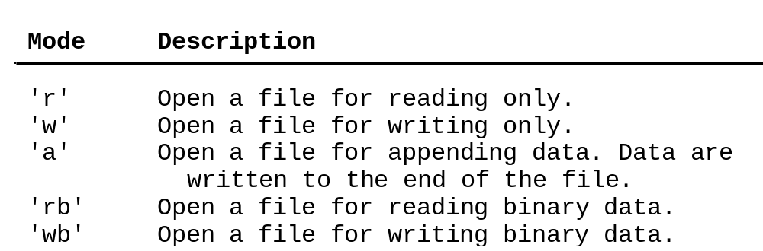
Open a File
How do you write data to a file and read the data back from a file? You need to create a file object that is associated with a physical file. This is called opening a file. The syntax for opening a file is as follows:
file = open(filename, mode)

Slide 5
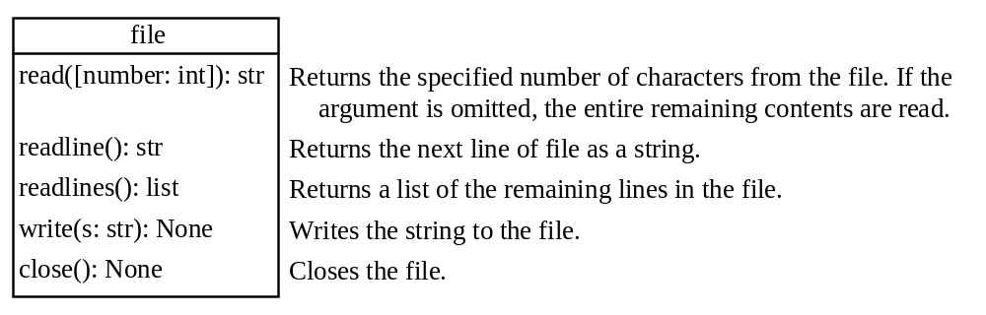
Write to a File
outfile = open("test.txt", "w")
outfile.write("Welcome to Python")
WriteDemo
Run

Slide 6
Testing File Existence
import os.path
if os.path.isfile("Presidents.txt"):
print("Presidents.txt exists")

Slide 7
Read from a File
After a file is opened for reading data, you can use the read method to read a specified number of characters or all characters, the readline() method to read the next line, and the readlines() method to read all lines into a list.
ReadDemo
Run

Slide 8
Append Data to a File
You can use the 'a' mode to open a file for appending data to an existing file.
AppendDemo
Run

Slide 9
Writing/Reading Numeric Data
To write numbers, convert them into strings, and then use the write method to write them to a file. In order to read the numbers back correctly, you should separate the numbers with a whitespace character such as ' ', '\n'.
WriteReadNumbers
Run

Slide 10
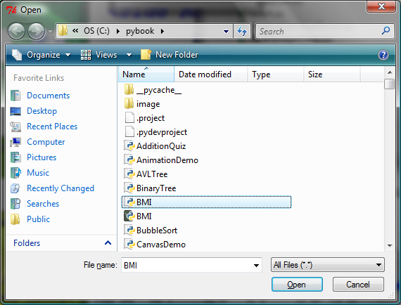
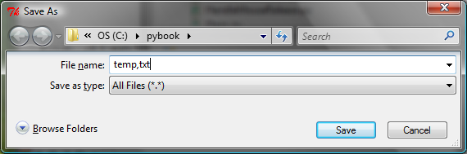
File Dialogs
from tkinter.filedialog import askopenfilename
from tkinter.filedialog import asksaveasfilename
filenameforReading = askopenfilename()
print("You can read from from " + filenameforReading)
filenameforWriting = asksaveasfilename()
print("You can write data to " + filenameforWriting)

Slide 11
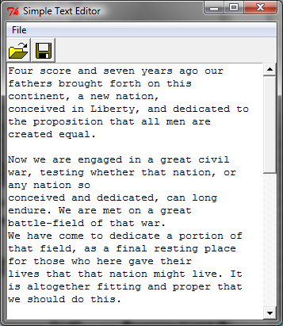
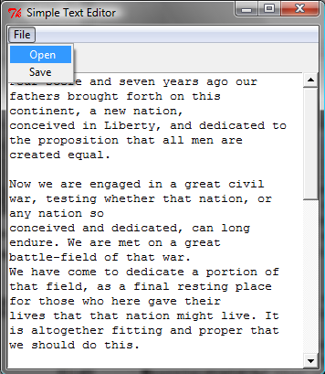
File Editor
FileEditor
Run

Slide 12
Problem: Counting Each Letter in a File
The problem is to write a program that prompts the user to enter a file and counts the number of occurrences of each letter in the file regardless of case.
CountEachLetter
Run

Slide 13
Retrieving Data from the Web
Using Python, you can write simple code to read data from a Website. All you need to do is to open a URL link using the urlopen function as follows:
infile = urllib.request.urlopen('http://www.yahoo.com')
import urllib.request
infile = urllib.request.urlopen('http://www.yahoo.com/index.html')
print(infile.read().decode())
CountEachLetterURL
Run

Slide 14
Exception Handling
When you run the program in Listing 11.3 or Listing 11.4, what happens if the user enters a file or an URL that does not exist? The program would be aborted and raises an error. For example, if you run Listing 11.3 with an incorrect input, the program reports an IO error as shown below:
c:\pybook\python CountEachLetter.py
Enter a filename: newinput.txt
Traceback (most recent call last):
File "CountEachLetter.py", line 23, in <module>
main()
File "CountEachLetter.py", line 4, in main
Infile = open(filename, "r"> # Open the file
IOError: [Errno 2] No such file or directory: 'newinput.txt'

Slide 15
Accessing the Exception Message
You can access the exception object in the except clause.
try:
number = eval(input("Enter a number: "))
print("The number entered is", number)
except Exception as ex:
print("Exception:", ex)

Slide 16
Detecting End of File
If you don’t know how many objects are in the file, how do you read all the objects? You can repeatedly read an object using the load function until it throws an EOFError exception. When this exception is raised, catch it and process it to end the file reading process.
DetectEndOfFile
Run

Slide 17
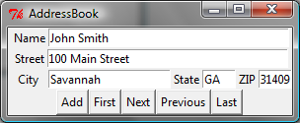
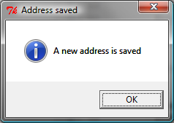
Case Study: Address Book
Now let us use object IO to create a useful project for storing and viewing an address book. The user interface of the program is shown below. The Add button stores a new address at the end of the file. The First, Next, Previous, and Last buttons retrieve the first, next, previous, and last addresses from the file, respectively.
AddressBook
Run

